Slide 1





Direct Payments
10th December 2021
England

Slide 2

Speakers
Adrian Snarr
Director of Financial Control, NHS England and Improvement
Jon Murphy
Head of Primary Care Estates
Commercial Directorate
NHS England and NHS Improvement
Alistair Ross
Senior Finance Manager,
NHS Oldham CCG
Sonia McRobb
Senior Company Strategy Manager
Department of Health and Social Care
Mark Powell
Regional Property Finance Manager – North West
Community Health Partnerships

Slide 3
Panellists
Harj Brar
Credit Control Manager
NHS Property Services
Helen Richardson
Credit Control Team Leader
Community Health Partnerships
Vicky Cockcroft
Commercial Strategy and Project Officer
Department of Health and Social Care

Slide 4
Agenda
Introduction to Direct Payments | Sonia McRobb
Why do we need Direct Payments? Benefits of Direct Payments and system Feedback from GPs | Adrian Snarr Adrian Snarr Jon Murphy
Direct Payments policy | Jon Murphy
Process overview | Mark Powell
Case Studies – Oldham | Alistair Ross
Q&A | Panel

Slide 5
Introduction
Sonia McRobb
Department of Health and Social Care
England

Slide 6
What are Direct Payments and how do they work?
Commissioner reimburses CHP or NHSPS directly for rent, rates, water and clinical waste
GP accounts for the transaction*
GP signs a Section 52 letter
(included in pack)
LMC engagement & support
*Recognising receipt of the cost from NHSPS or CHP (debit) and reimbursement from CCG (credit).

Slide 7
Outstanding Property Company Reimbursable Debt
£42.3m outstanding
£53.1m outstanding

Slide 8
Cash collected through Direct Payments to date

Slide 9
Why do we need Direct Payments?
Adrian Snarr
NHS England and Improvement
England

Slide 10
Why do we need Direct Payments?
Current system
Direct Payments
Outstanding reimbursable debt is high:
  Potential enforcement action
  Risk to service continuity
  Adverse media coverage
Servicing debt is costly:
  Working capital loans
  Interest
  Administration
Reimbursable debt and potential consequences resolved at source
Clarity and transparency
Reduced administrative burden on GP and fewer recovery costs

Slide 11
Benefits of Direct Payments
Adrian Snarr
NHS England and Improvement
England

Slide 12
Benefits of Direct Payments
GP
NHSPS and CHP
NHSE&I and CCGs
  Less administration
  Greater clarity
  Shared Benefits
  Improves efficiency – fewer financial transactions required
  Better VfM – money remains in NHS family
  Timely payments
  Stronger relationships
  Greater clarity
  Reduction in ad hoc queries
  Stronger relationships
  Changes to demise would mean the CCG is automatically made aware through property companies
Notes:
Adrian:
Simplifies financial transactions – removing some inefficiency (instead of paying the GP the commissioner pays the property company)
Reduction in administration for GPs – once the letter is agreed, the GP receives a copy of the invoice, but it does not need to make this payment
Funding remains in the NHS family – there have been instances where GPs have moved the funds between groups which has meant they have received money that was never used for the intended purpose?
Timely payments – this is important because as you will have seen from the following slide? this funding is not passed on in a timely manner and whilst it does get passed on there is a cost which is ultimately passed back to the customers for working capital loans to fund property companies.
Provides clarity for commissioners on the payments (through schedules), accounting, but also what’s going on with the payments, where the money has gone and if they are going to have to deal with an issue of a GP relating to enforcement
As part of new GP Payment and Pensions system being introduced, NHSE&I have agreed an alteration which will enable the payments made to prop cos to be automated, rather than made manually as is currently the case.
I’ll now hand over to Jon who will share some feedback from GPs who are using Direct Payments.

Slide 13
Feedback from GPs
Jon Murphy
NHS England and Improvement
England

Slide 14
Feedback from GPs
“I would recommend the direct payment scheme to other GP Practices. It saves a lot of time and takes pressure off those making payments to NHS property services. It is one less task for management.”
- Picton Medical Centre, Bradford

Slide 15
Direct Payments policy
Jon Murphy
NHS England and Improvement
England

Slide 16
Direct Payments policy position
Trial of direct payments concluded
Expansion of trial
Direct Payments are fully supported by NHSE&I
Compulsory for new GP occupiers in NHSPS and CHP properties
Recommended when changes are made to occupancies
Confirmation that management fees for reimbursable costs (CHP and NHSPS only) are reimbursable for GPs

Slide 17
Direct Payments process
Mark Powell
Community Health Partnerships
England

Slide 18
Direct Payments process
Step 1
CHP/ NHSPS and the CCG agree the Direct Payment Process
Step 2
NHSE provides the CCG with a Section 52 document confirming reimbursables for direct payment and CCG sends to the GP for approval
Step 3
GP must inform CHP/NHSPS and CCG of any changes in occupancy
Step 4
Step 5
Step 6
Step 7
Step 8
Step 9
CHP/ NHSPS bill GP monthly/ quarterly for rent & rates, water and clinical waste with charges reconciled during the true-up / year-end reconciliation process at end of financial year
CHP/ NHSPS double check invoices with relevant stakeholders before issuing them to GP
CHP/ NHSPS send GP the Annual Charging Schedule (ACS) and invoices. The ACS is also shared with the CCG
CHP/ NHSPS pledge to assist the CCG and GP to resolve queries promptly
CHP/ NHSPS send CCG a payment request form. CCG makes payment to CHP/NHSPS within terms
Payments allocated against reimbursable charges within 10 working days of receipt

Slide 19
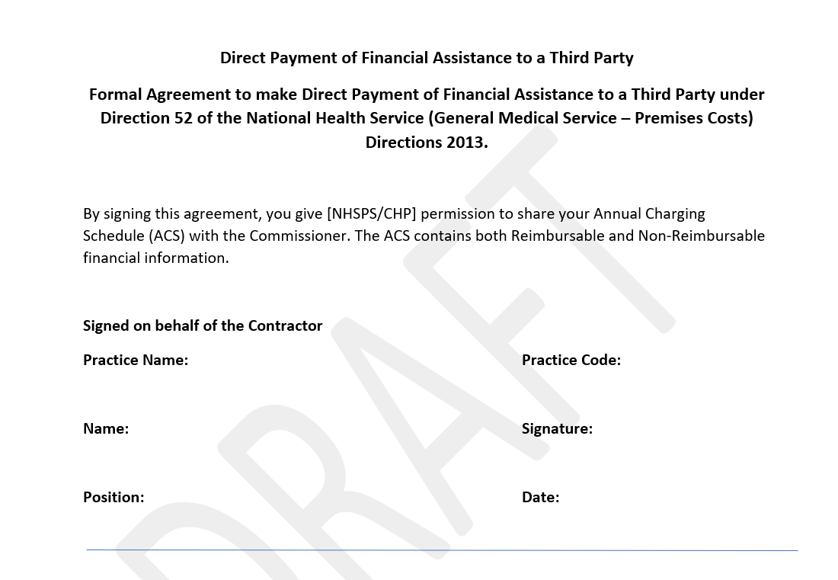
S52 Letter (template)
In line with Premises Costs Directions.
Agreed between a GP practice and the commissioner.
Payment covers the rent, rates, clinical waste and water charges.
GP practice can revoke by providing six months’ notice in writing to the CCG and the third party.

Slide 20
Case Study: Oldham CCG
Alistair Ross
Oldham CCG
England

Slide 21
Oldham CCG – progress to date
Why did Oldham CCG join the scheme?
Reduce the burden on GP admin
Help resolve some of GP debt issues
Reduces queries and ongoing monthly admin (after initial process to set up)
CCG, CHP and GPs working as one team to get reimbursables paid
Benefits to Oldham CCG
Clarity on charges improves cash planning
Assurance that funding is used for intended purpose
Improved communication with property companies
Opportunity for property companies to focus on non-reimbursable debt due to time saved
Benefits to GPs
Less time involved in resolving issues
Reduction in reimbursable debt
Better clarity on remaining costs
11 / 18 GPs signed up since September 2021
Total debt in region:
£2.99 million
Non-reimbursable debt in region:
£1.34 million
Reimbursable debt in region:
£1.65 million

Slide 22
Q&A
England

